Slide 1
CHAPTER 11 UNOBTRUSIVE RESEARCH

Slide 2
Chapter Outline
Introduction
Content Analysis
Analyzing Existing Statistics
Comparative and Historical Research
Ethics and Unobtrusive Measures
Chapter Summary
Questions

Slide 3
Content Analysis (slide 1 of 3)
Unobtrusive Research – Methods of studying social behavior without affecting it.
Types of Unobtrusive Research
Content Analysis
Analysis of Existing Statistics
Comparative and Historical Analysis

Slide 4
Content Analysis (slide 2 of 3)
Content Analysis – The study of recorded human communications (e.g., books, newspapers, websites, paintings, laws).
Appropriate Topics
“Who says what, to whom, why, how, and with what effect?”

Slide 5
Content Analysis (slide 3 of 3)
Example: violence on TV
Develop operational definitions
Decide what to observe
Decide how to code/analyze data

Slide 6
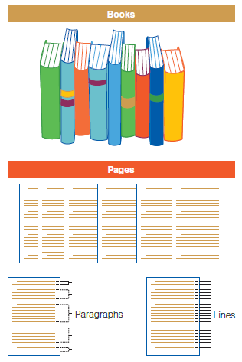
Figure 11-1
A Few Possible Units of Analysis for Content Analysis

Slide 7
Content Analysis
Identify the unit of analysis:
You are interested in how children’s literature portrays gender roles.
You are interested in popular film’s use of drugs and alcohol.
You are interested in sociology textbooks’ definition of race.
You are interested in the content of Internet blogs.

Slide 8
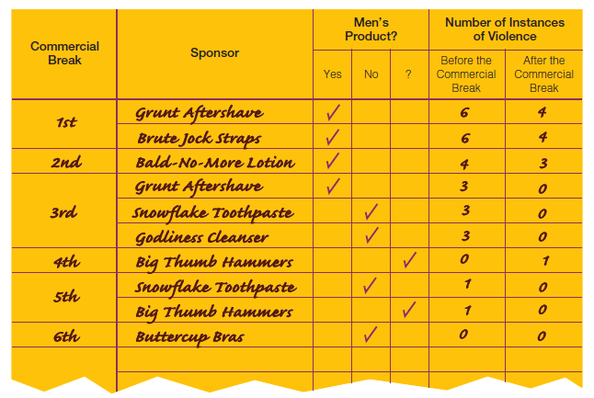
Figure 11-2
Example of Recording Sheet for TV Violence

Slide 9
Content Analysis (slide 1 of 3)
Sampling Techniques
Any conventional sampling technique may be used for content analysis.

Slide 10
Content Analysis (slide 2 of 3)
Coding in Content Analysis
Coding – The process whereby raw data are transformed into standardized form suitable for machine processing and analysis.

Slide 11
Content Analysis (slide 3 of 3)
Manifest Content – The concrete terms contained in a communication.
Latent Content – The underlying meaning of communication.

Slide 12

Figure 11-3
Manifest Coding of Materials (Objective)
Manifest coding involves the counting of specific elements, such as the word love, to determine whether and to what degree the passage should be judged “romantic.”

Slide 13

Figure 11-3 (cont’d)
Latent Coding of Materials (Subjective)
Latent coding calls for the researcher to view the entire unit of analysis (a paragraph in this case) and make a subjective assessment regarding whether and to what degree it is “romantic.”

Slide 14
Content Analysis
Conceptualization and the Creation of Code Categories
Attributes
Levels of Measurement
Counting and Record Keeping
The end product of coding must be numerical.
Numerical coding needs a denominator.

Slide 15
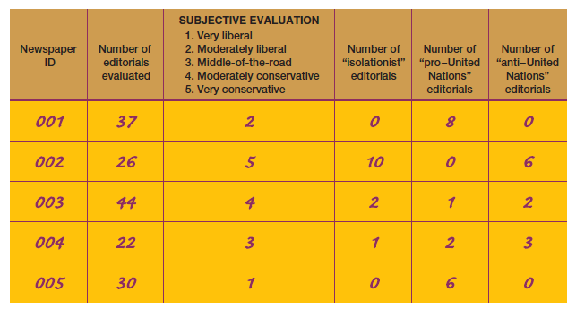
Figure 11-4
Sample Tally Sheet (Partial)

Slide 16
Content Analysis (slide 1 of 2)
Illustrations of Content Analysis

Slide 17
Content Analysis (slide 2 of 2)
Strengths of Content Analysis
Economy of time and money
Allowing for the correction of errors
Permits the study of processes occurring over time
Research has little (if any) effect on subjects
Reliability
Weaknesses of Content Analysis
Limited to recorded communications
Validity

Slide 18
Analyzing Existing Statistics (slide 1 of 4)
Existing statistics may be the main source of data or a supplemental source of data.
Example: Durkheim’s Study of Suicide

Slide 19
Analyzing Existing Statistics (slide 2 of 4)
Units of Analysis
By nature, existing statistics describe groups.
Ecological Fallacy

Slide 20
Analyzing Existing Statistics (slide 3 of 4)
Problems of Validity
Logical Reasoning
Replication
Problems of Reliability
Quality of Existing Statistics

Slide 21
Analyzing Existing Statistics (slide 4 of 4)
Sources of Existing Statistics
Statistical Abstract of the United States
Government Data
Demographic Yearbook

Slide 22
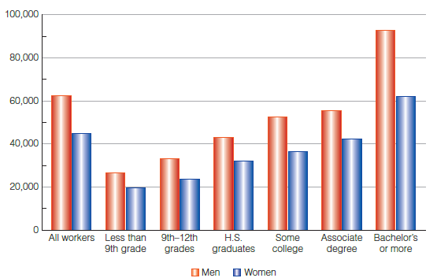
Figure 11-5
Graphic Display of Gender, Education, and Income

Slide 23
Ethics and Unobtrusive Measures
Even unobtrusive measures can raise the possibility of violating subjects’ privacy.
The general principles of honest observation, analysis, and reporting apply to all research techniques.

Slide 24
Chapter Summary
Understand the use of content analysis for both qualitative and quantitative social research.
Give examples of researchers analyzing existing statistics, to illustrate the strengths and weaknesses of this method.
Describe comparative and historical methods and give examples to illustrate.
Understand the ethical issues involved in the various methods of unobtrusive research.

